Slide 1




NEXT GEN EMPLOYABILITY PROGRAM
Creating a future-ready workforce
Team Members
College Name
Student Name: sanga Mithra.J
Student ID : au960221243041
Arunachala College Of Engineering For Women

Slide 2

CAPSTONE PROJECT SHOWCASE
Project Title
Car Rentals Application with Django Framework
Abstract | Problem Statement | Project Overview | Proposed Solution | Technology Used | Modelling & Results | Conclusion

Slide 3
Abstract:
This paper presents the design and development of a comprehensive car rental application aimed at enhancing the user experience in the realm of modern mobility. The application integrates advanced features such as real-time vehicle availability, secure payment processing, user-friendly interface, and robust reservation management system. Utilizing state-of-the-art technologies including GPS tracking and machine learning algorithms, the application ensures efficient fleet management and optimal allocation of resources. Moreover, emphasis is placed on user convenience through personalized recommendations, seamless booking process, and responsive customer support. The proposed application offers a scalable solution to meet the growing demands of the car rental industry, facilitating smooth and hassle-free mobility for users worldwide.
Source :

Slide 4
Problem Statement:
The problem statement for a car rentals application could be: "Design and develop a user-friendly mobile application that allows users to easily search, compare, and book rental cars from various providers, while providing features such as secure payment options, real-time availability, and efficient customer support."
Source :

Slide 5
Project Overview:
The car rentals application aims to provide users with a convenient platform to rent vehicles for various purposes. Key features include user registration, vehicle selection, booking management, payment processing, and user feedback. The app will offer a diverse range of vehicles, flexible booking options, and seamless user experience to enhance customer satisfaction and retention. Additionally, the application will incorporate robust security measures to safeguard user data and transactions.
Source :

Slide 6
Proposed Solution:
A comprehensive car rental application could include features like user-friendly booking interfaces, vehicle selection based on preferences, real-time availability tracking, secure payment processing, seamless communication between users and rental agencies, and integrated GPS for navigation. Additionally, implementing features such as user reviews, loyalty programs, and customer support channels can enhance user experience and satisfaction.
.
Source :

Slide 7
  Creating a Next Gen Employability program for a car rentals application involves several components:
  Skill Development: Identify key skills required for roles within the company, such as customer service, sales, vehicle maintenance, and administration.
  Training Modules: Develop training modules focusing on these skills, including both theoretical knowledge and practical application.
  Technology Integration: Incorporate training on using the car rentals application effectively, including booking management, vehicle tracking, and customer communication features.
  Soft Skills: Include training on soft skills like communication, problem-solving, teamwork, and adaptability, essential for success in any role.
Source :

Slide 8
  Mentorship Program: Pair new hires with experienced employees to provide guidance and support throughout their training period.
  Assessment and Feedback: Implement regular assessments to track progress and provide constructive feedback to employees, helping them improve continuously.
  Career Path Development: Offer opportunities for advancement within the company, with clear pathways and development plans for employees to progress in their careers.
  Continuous Learning: Encourage a culture of continuous learning and skill development through ongoing training sessions, workshops, and access to online resources.
  By implementing these components, the Next Gen Employability program can effectively prepare employees for success within the car rentals application, enhancing their employability and contributing to the company's overall success.
Source :

Slide 9


Technology Used
Front-end
Back-end
Source :

Slide 10
Modelling & Results:
A Next Gen Employability program for car rentals could focus on incorporating cutting-edge technology such as AI-driven vehicle tracking systems, predictive maintenance algorithms, and customer experience enhancements. The program would involve training employees in utilizing these technologies effectively, developing problem-solving skills, and fostering a customer-centric mindset. Results could include improved operational efficiency, reduced downtime, enhanced customer satisfaction, and a skilled workforce ready to adapt to future industry trends.
Source :

Slide 11
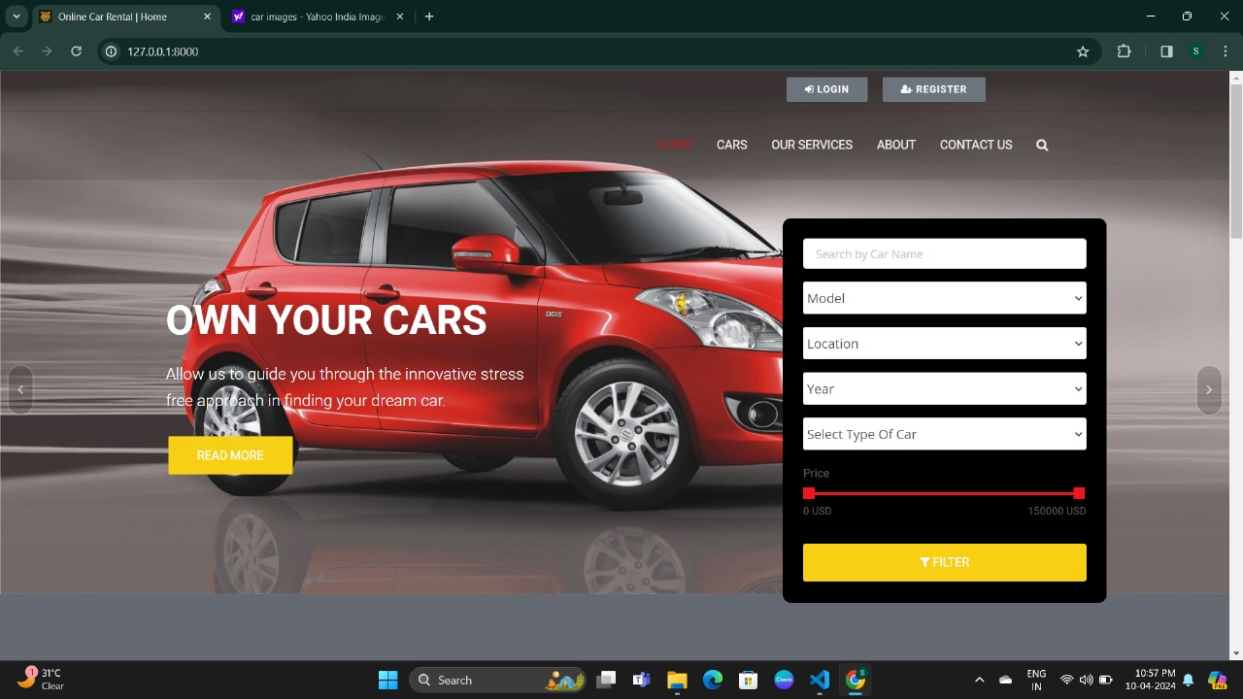
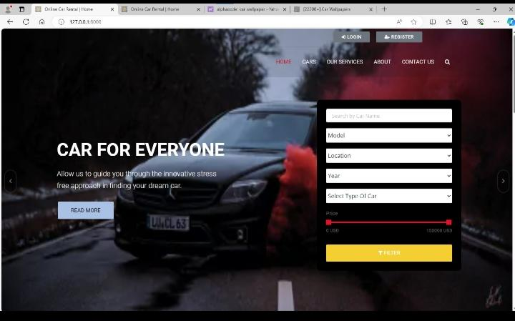
Homepage

Slide 12
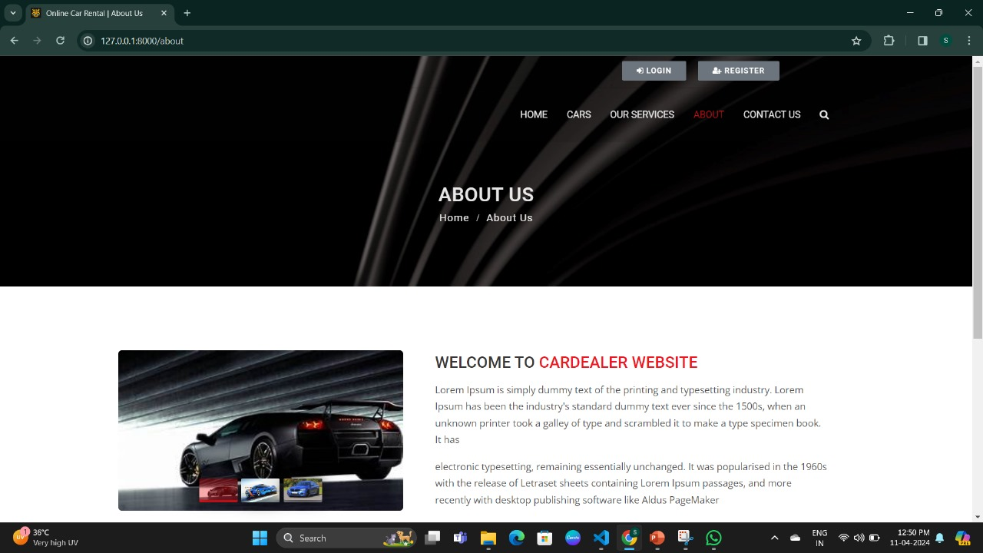
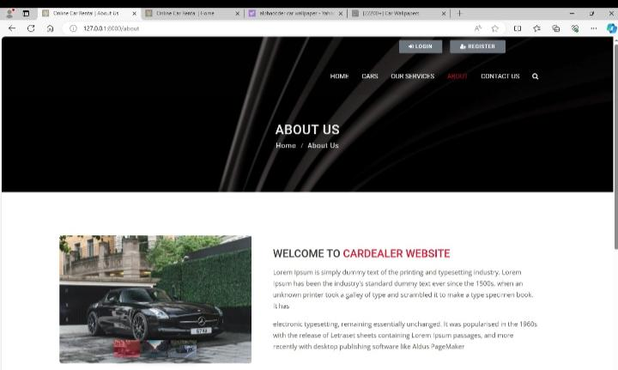
About-Us-Page

Slide 13
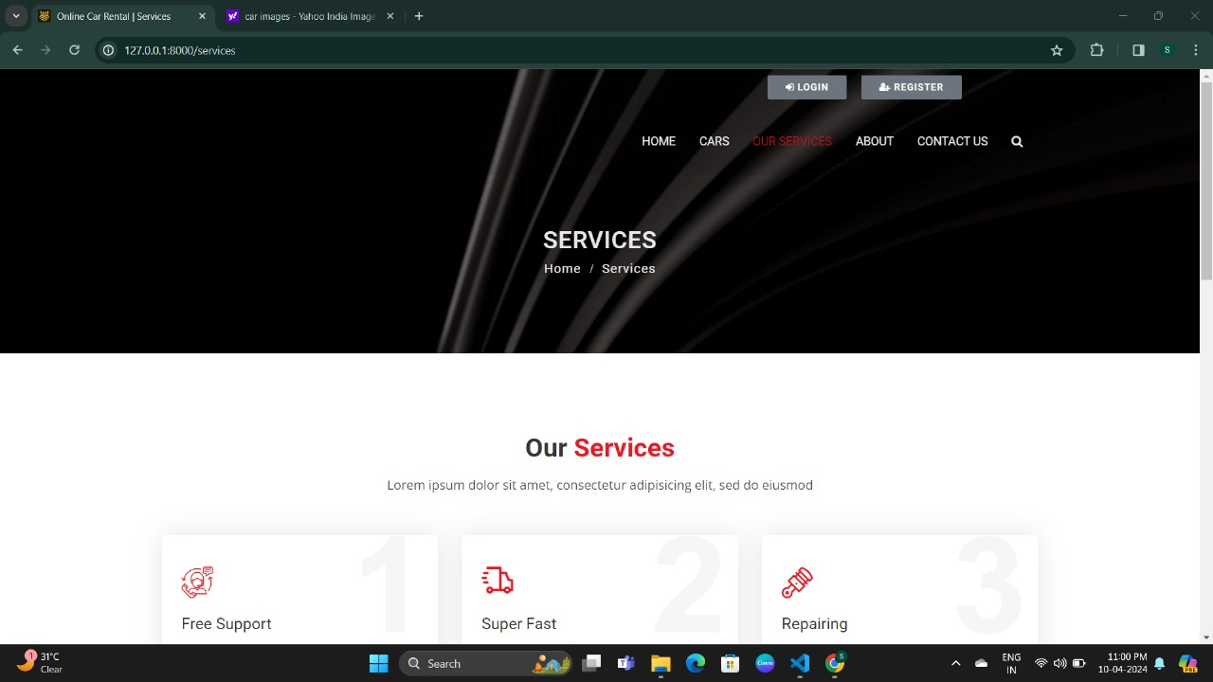
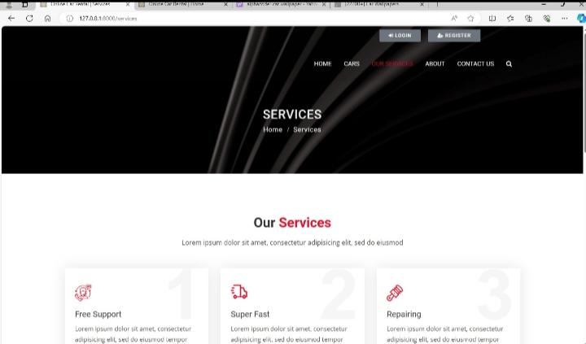
Service-Page

Slide 14
Future Enhancements:
One potential future enhancement for a car rentals application could be implementing a feature that allows users to schedule and pay for car maintenance services directly through the app. This could include options for regular maintenance like oil changes, tire rotations, and inspections, making it more convenient for users to keep their rental cars in good condition.

Slide 15
Conclusion:
In conclusion, a car rentals application offers convenience, flexibility, and choice to users. By providing a user-friendly interface, a wide selection of vehicles, transparent pricing, and efficient booking and support systems, the application can enhance the overall experience for both renters and car owners. Additionally, integrating features such as GPS navigation, digital contracts, and vehicle tracking can further streamline the rental process, ensuring customer satisfaction and loyalty. With the increasing demand for mobility solutions, investing in technology-driven car rental platforms presents a promising opportunity for growth and innovation in the transportation industry.
Source :

Slide 16
Thank You!
Notes:
Thank You !!

